Slide 1
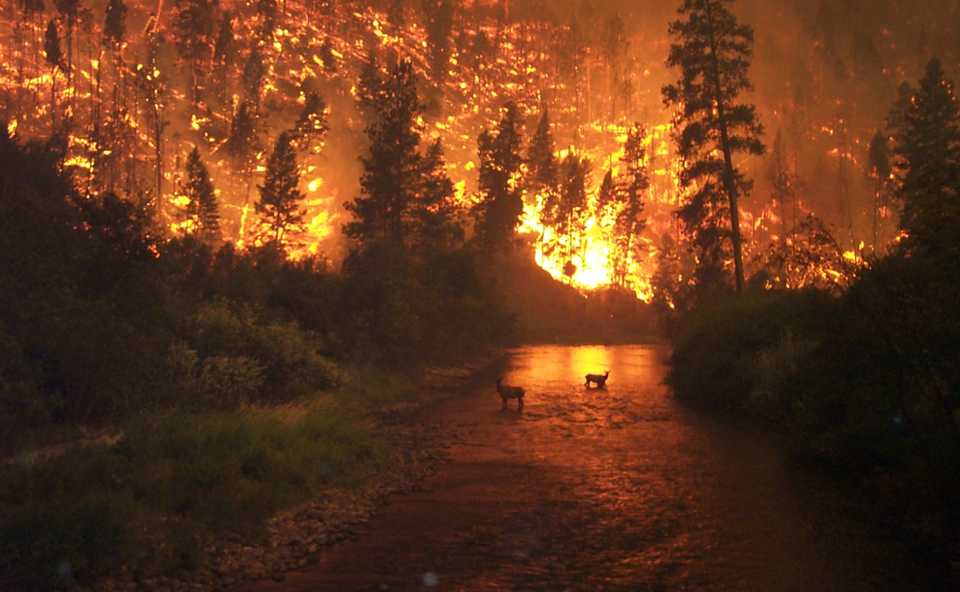
TRAILS, BLAZING:
HOW FIRE IN BOREAL SYSTEMS AFFECTS MAMMAL COMMUNITIES
JASON T FISHER

Slide 2
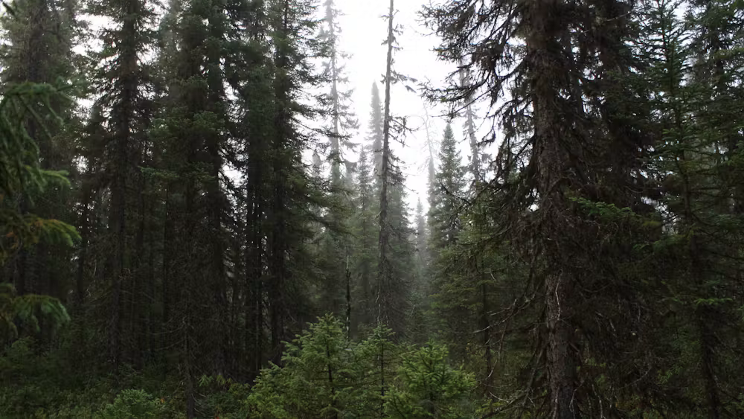
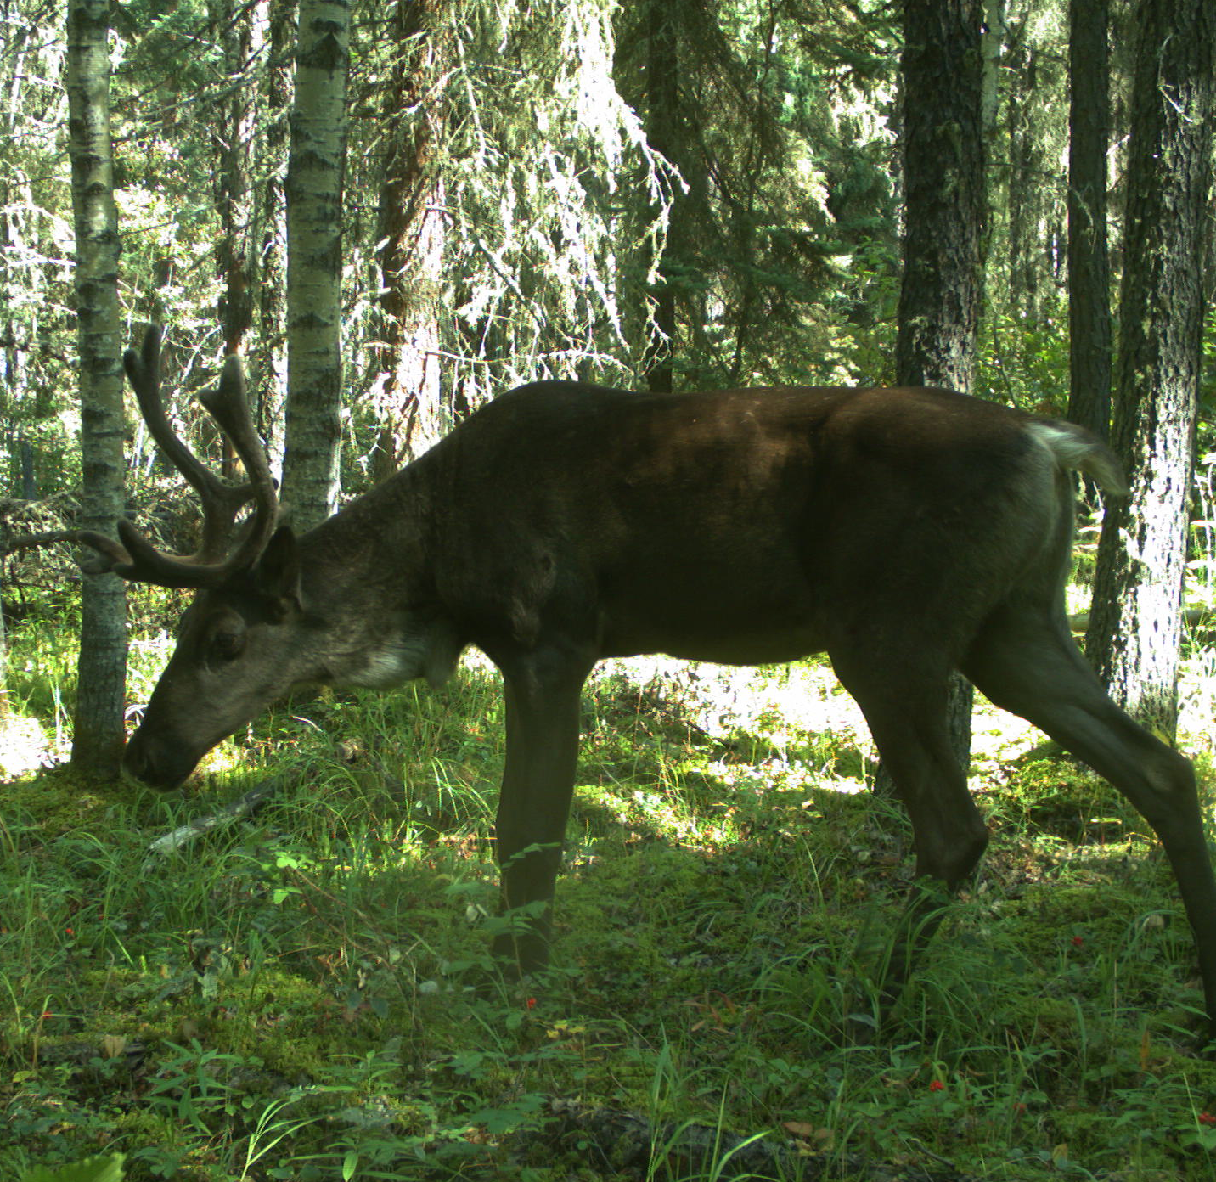
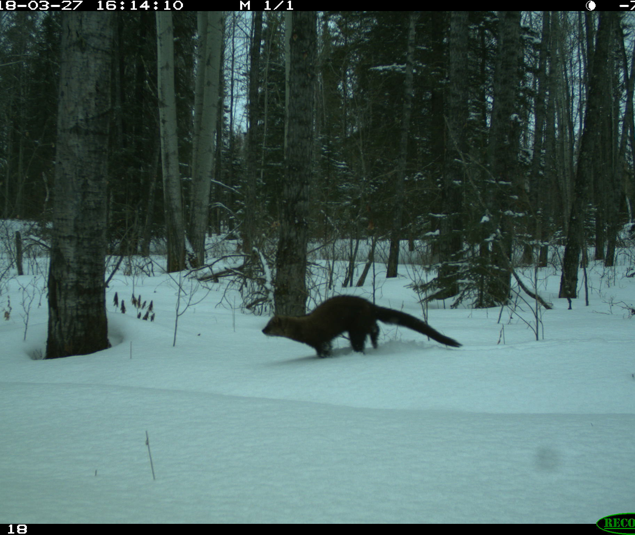
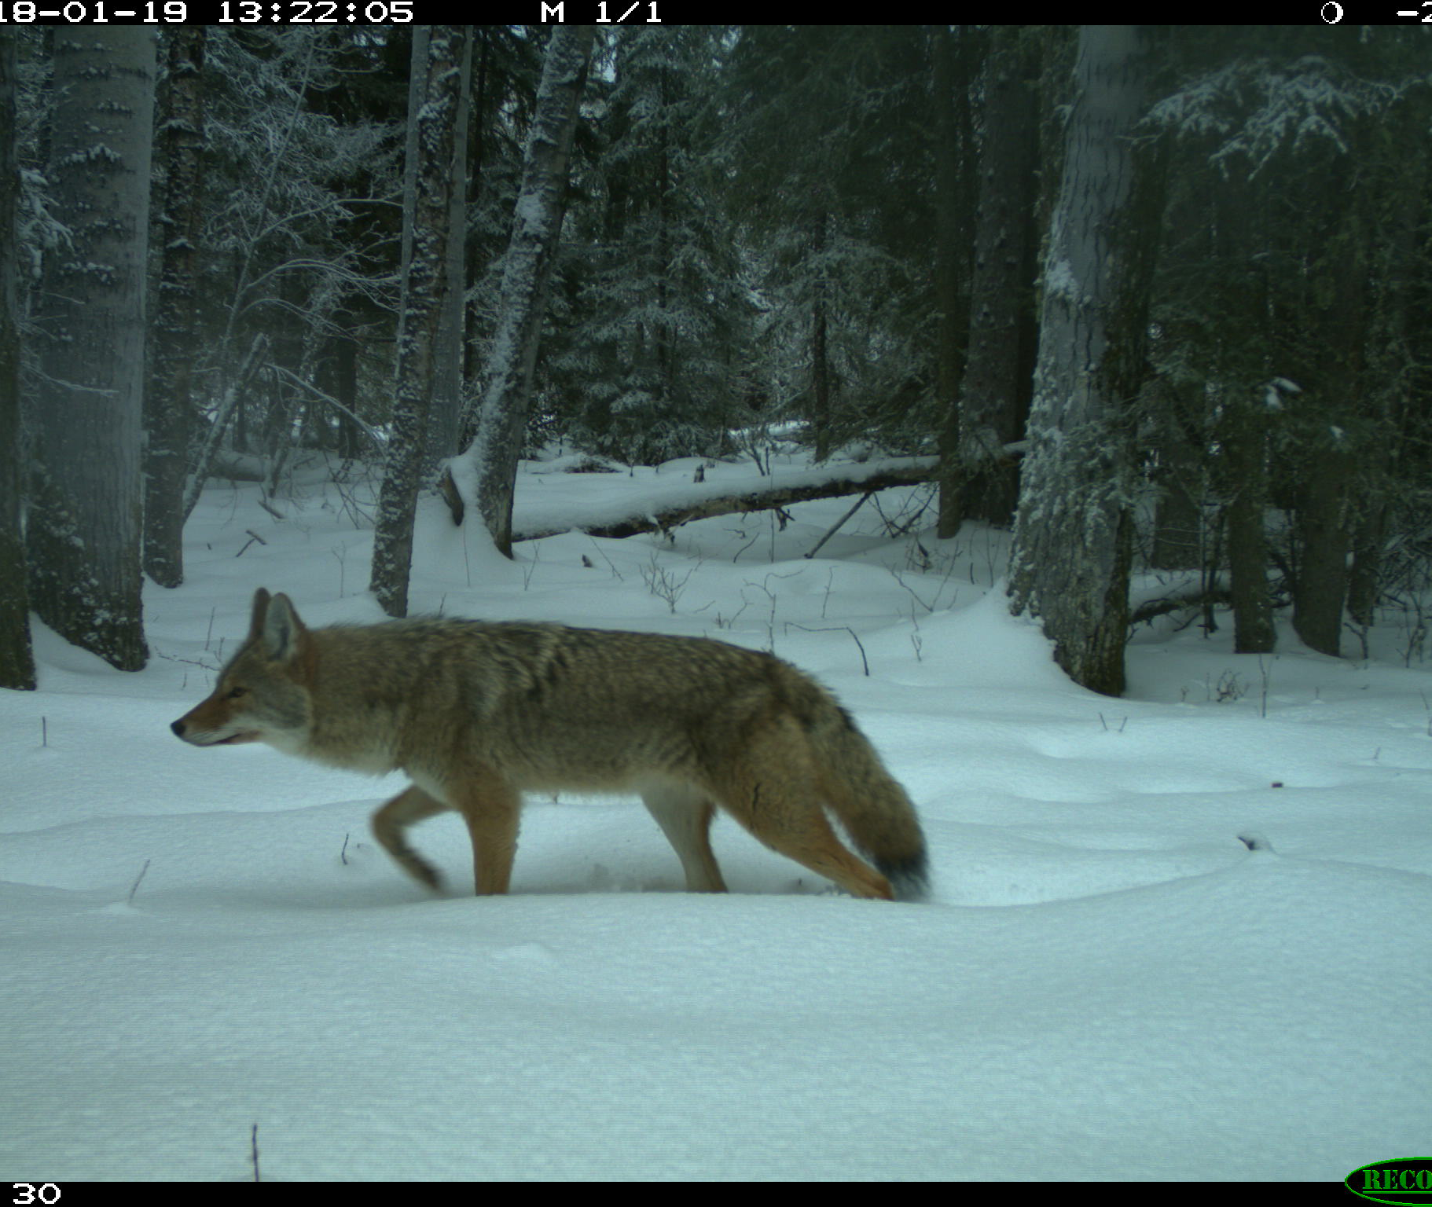
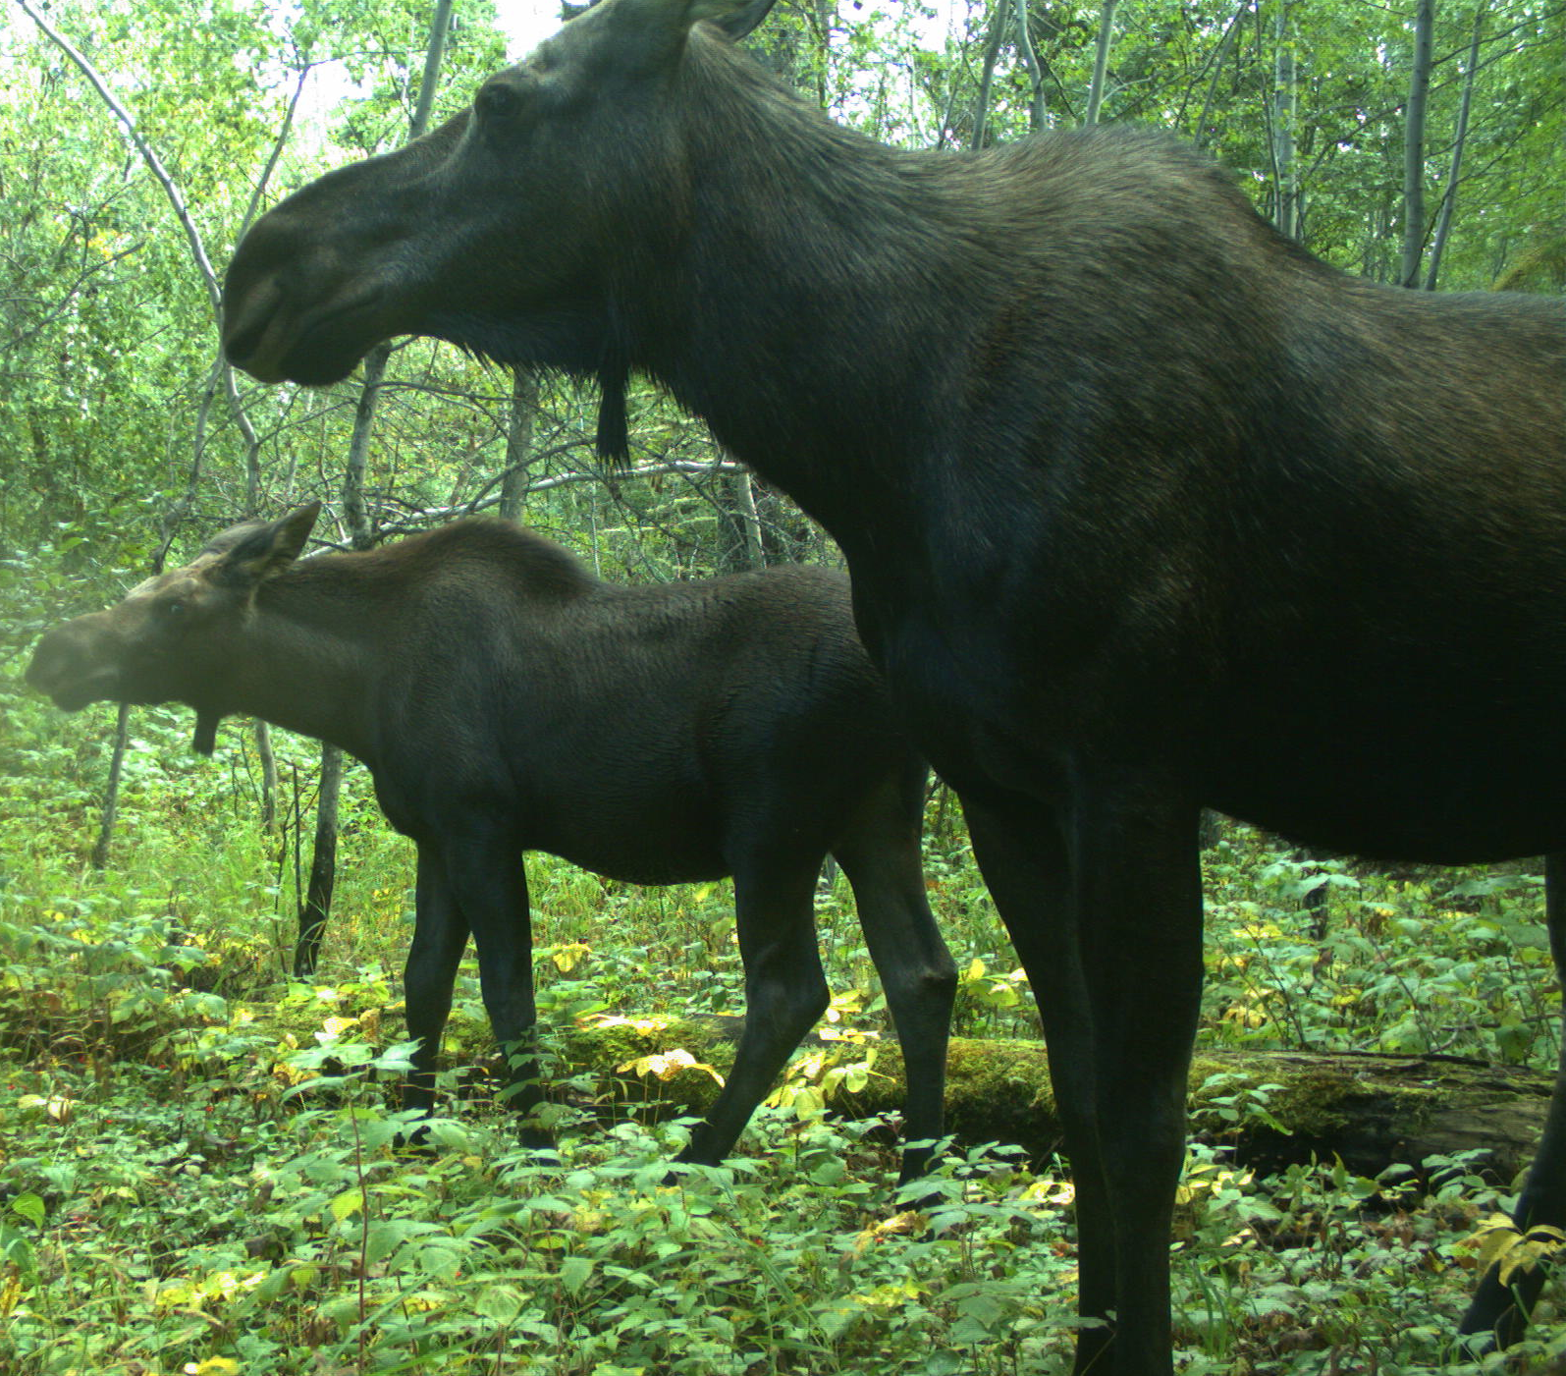
OLD GROWTH:
SOMETHING FOR
EVERYONE
MAXENCE MARTIN

Slide 3
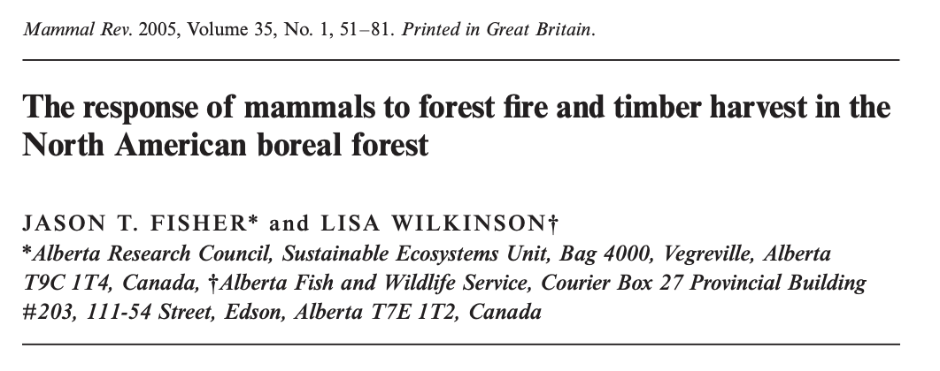
Notes:
We reviewed 100s of papers – I guess it was useful, it’s 2 shy of 500 citations. No one has updated it yet.

Slide 4
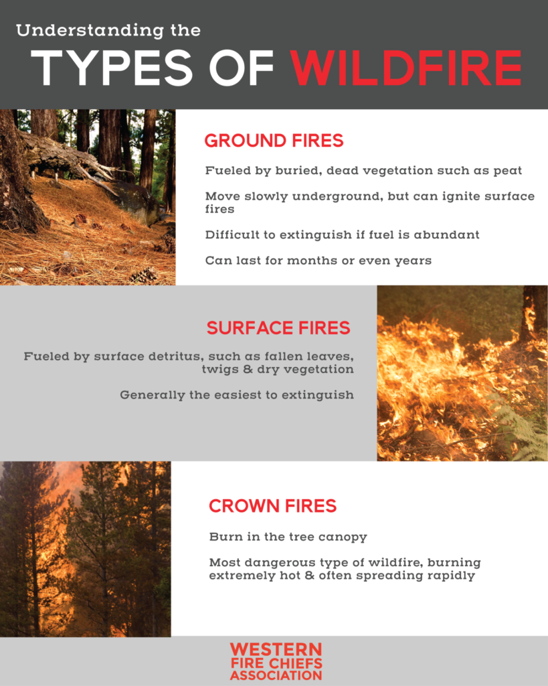

Slide 5
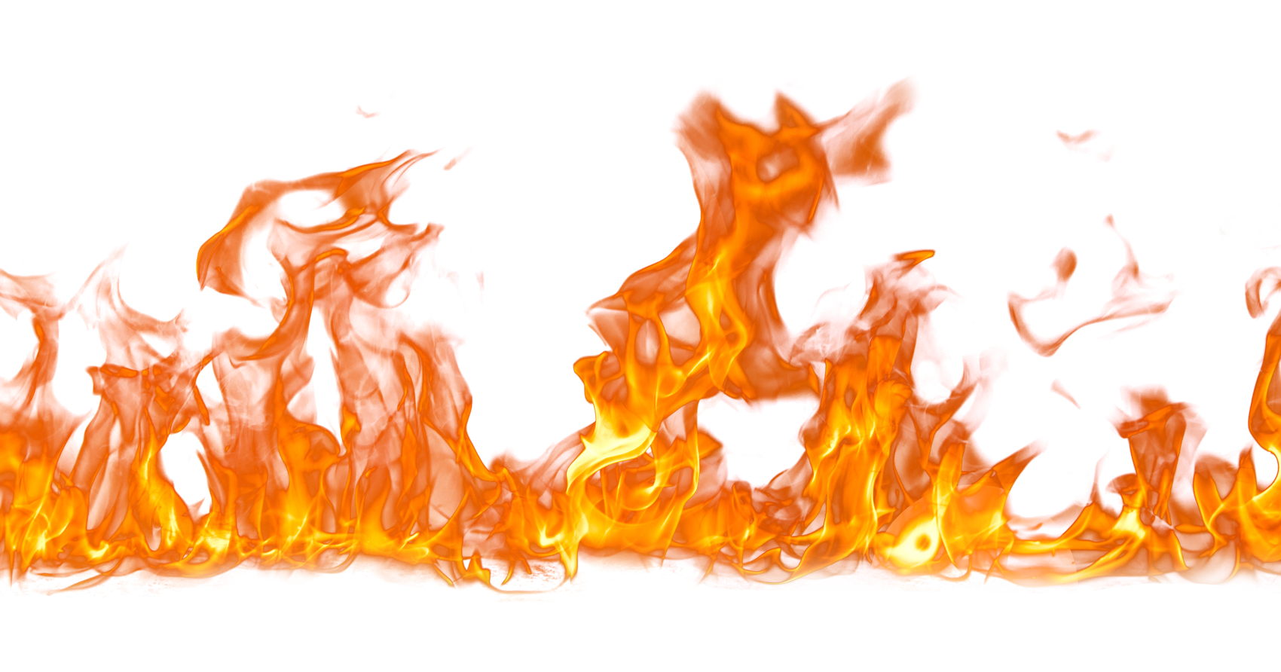
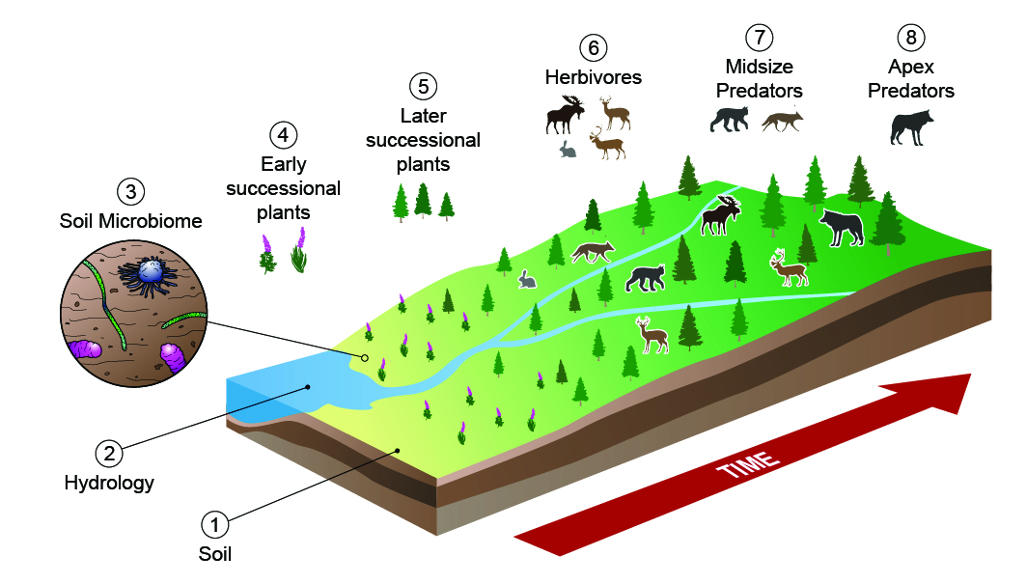
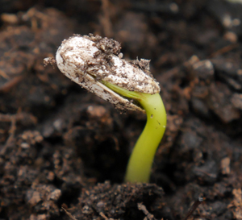
AGGRADATION STAGE 26-75 YRS
MATURE STAGE 76-125 YRS
OLD GROWTH STAGE 125+ YRS
ESTABLISHMENT STAGE 11-25-10 YRS
INITIATION STAGE 0-10 YRS
SEED BANK: 0 YRS
Illustration: JT Fisher & Jeff Dixon

Slide 6
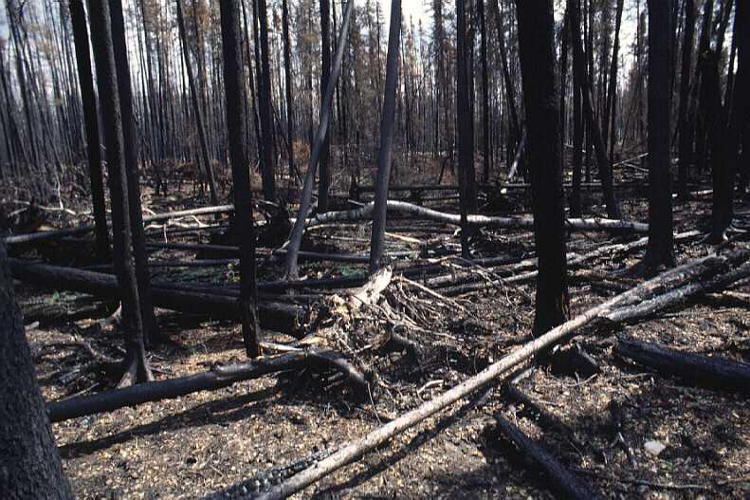
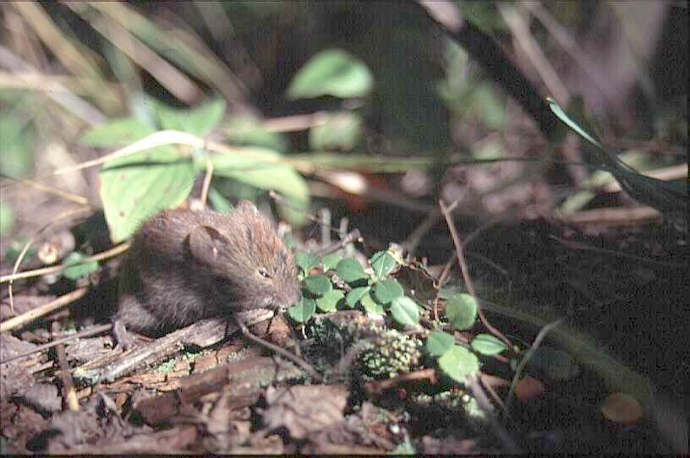
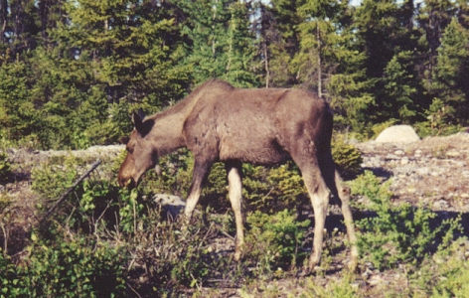
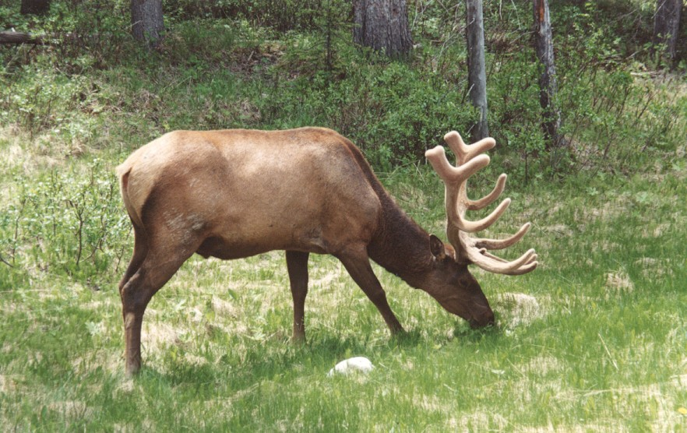
INITIATION STAGE: 0-10 YEARS AFTER FIRE
OVERALL INCREASE IN ABUNDANCE OF THE SMALL MAMMAL COMMUNITY
DOMINANCE SHIFT FROM RED-BACKED VOLES TO DEER MICE
CONSIDERABLE SITE-SITE VARIABILITY IN RESPONSE
YOUNG SERAL VEGETATION PROVIDES MOOSE, DEER AND ELK FORAGE
MOOSE ARE VERY ABUNDANT POST-FIRE
LACK OF ESCAPE COVER MODERATES RECOLONISATION
DOWNED WOODY MATERIAL IMPEDES MOVEMENT AND RECOLONISATION

Slide 7
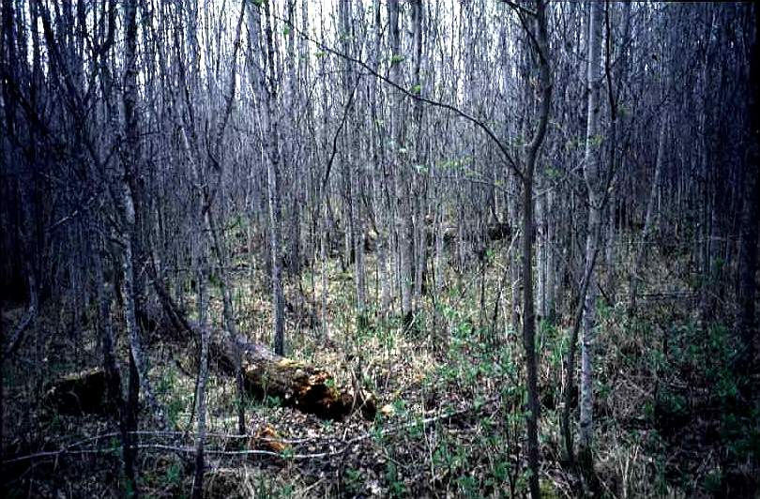
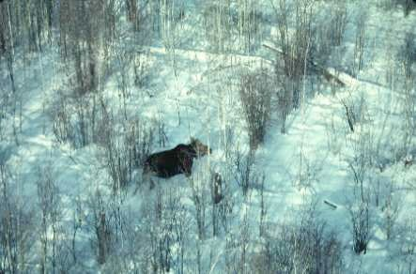
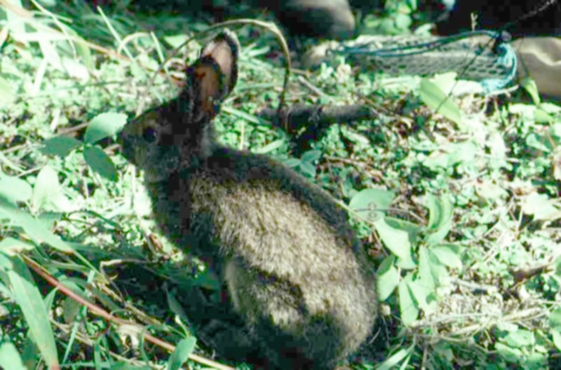
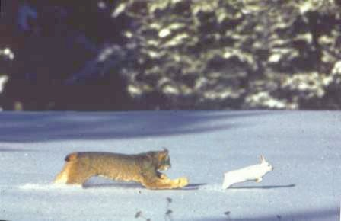
ESTABLISHMENT STAGE: 11-25 YEARS POST FIRE
INCREASING SHRUB COVER LEADS TO INCREASE IN SMALL MAMMAL ABUNDANCE
SPECIES DOMINANCE BEGINS TO SHIFT FROM DEER MICE TO RED BACKED VOLES
MOOSE AND DEER ARE LESS ABUNDANT THAN IN YOUNGER STANDS, AND MORE ABUNDANT THAN IN OLDER STANDS
HARES OCCUR IN THE HIGHEST ABUNDANCE IN THESE STAGE DUE TO THE ABUNDANCE OF UNDERSTOREY SHRUB COVER

Slide 8
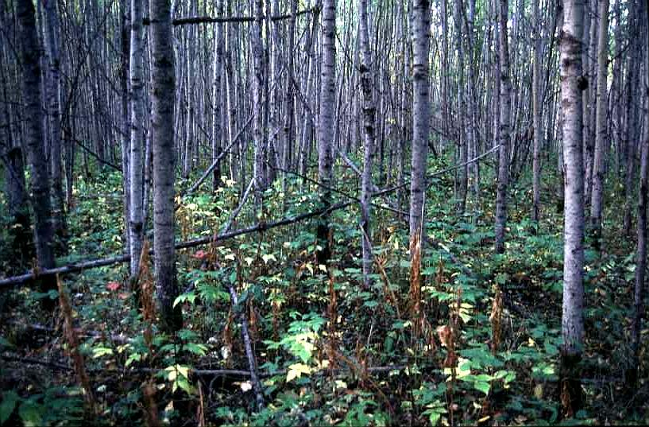
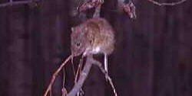
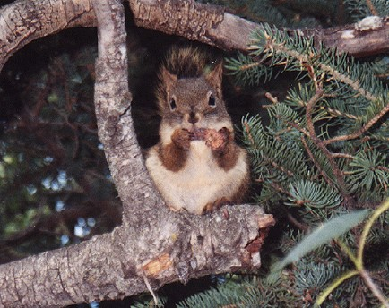
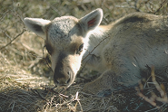
AGGRADATION STAGE: 26-75 YEARS POST FIRE
SMALL MAMMAL ABUNDANCE DECLINES
>>> SITE-SITE VARIABILITY EXISTS
BATS AND SQUIRRELS INCREASE IN ABUNDANCE
>>> SITE-SITE VARIABILITY EXISTS
LYNX AND HARES ARE IN HIGH, BUT DECREASING, ABUNDANCE
WOLVES ARE MODERATELY ABUNDANT
INCREASING LICHEN MAKES FORESTS FINALLY SUITABLE FOR CARIBOU

Slide 9
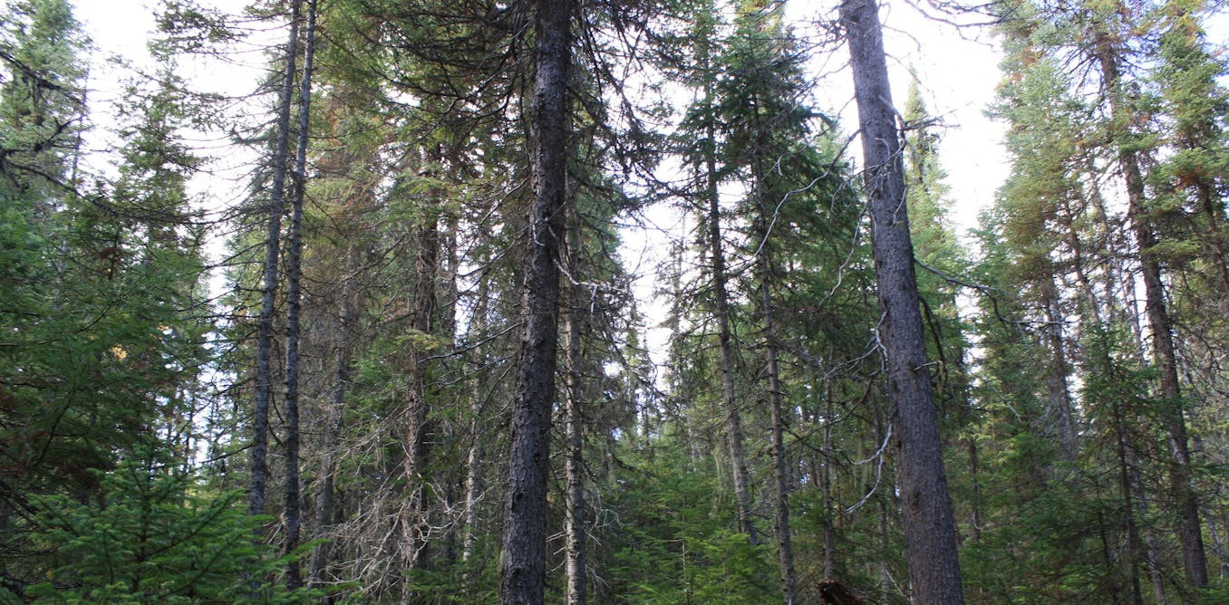
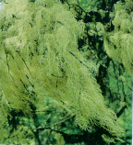
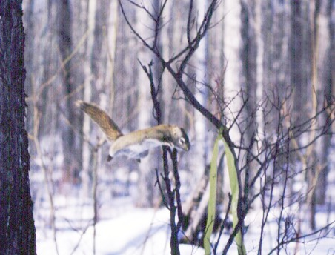
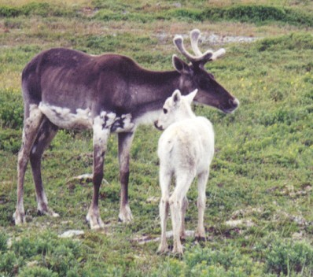
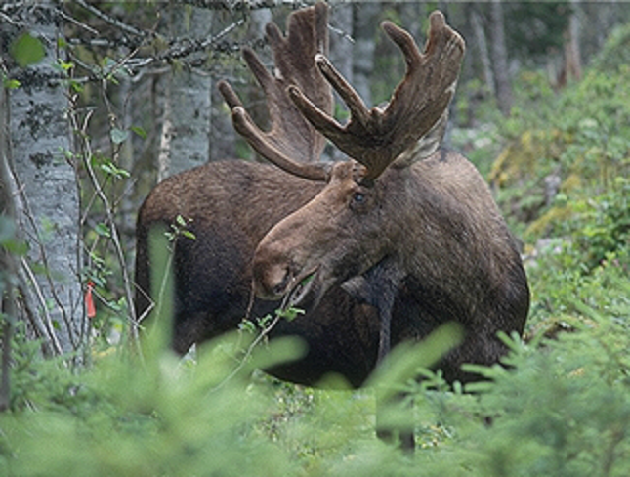
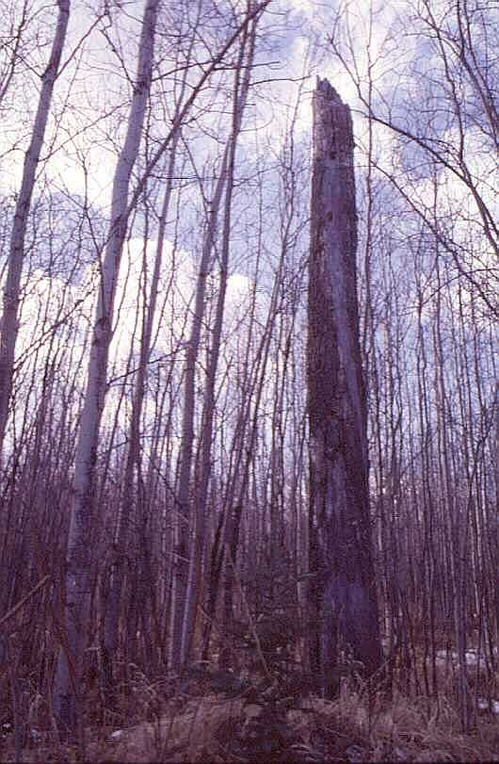
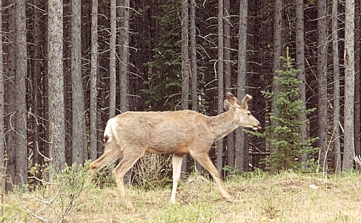
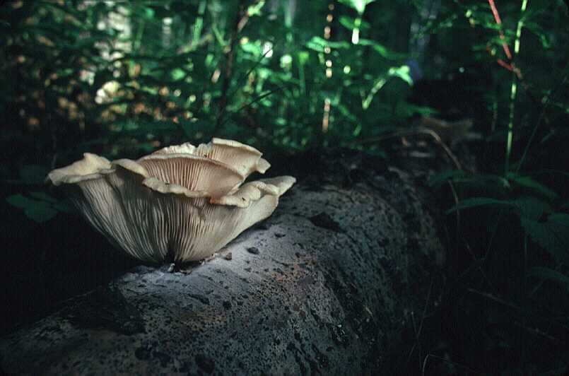
MATURE / OLD GROWTH STAGES: 76-125+ YEARS POST FIRE

Slide 10
EVERY STRUCTURE AND SEED THAT REMAINS IN THIS STAGE…
DICTATES WHAT THE STAND WILL MAINTAIN OVER THE NEXT CENTURY(IES)
Illustration: JT Fisher & Jeff Dixon

Slide 11
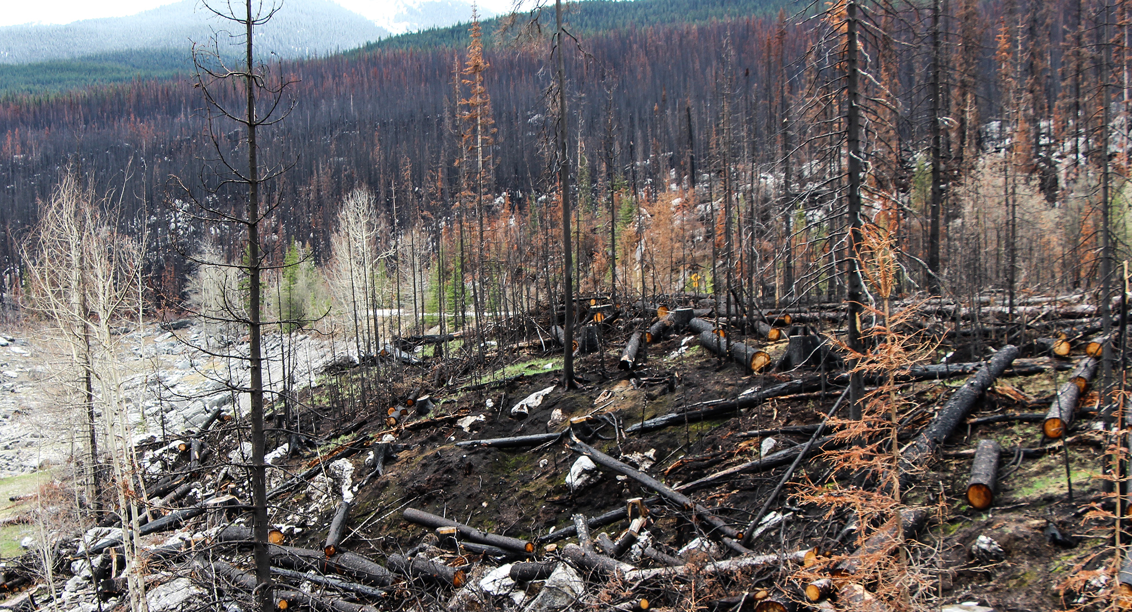
WHAT STRUCTURE REMAINS DICTATES WHAT MAMMALS REMAIN
WOODWELL CLIMATE RESEARCH CENTRE

Slide 12
WHAT STRUCTURE REMAINS DICTATES WHAT MAMMALS REMAIN
WOODWELL CLIMATE RESEARCH CENTRE

Slide 13
WHAT STRUCTURE REMAINS DICTATES WHAT MAMMALS REMAIN
WOODWELL CLIMATE RESEARCH CENTRE

Slide 14
WHAT STRUCTURE REMAINS DICTATES WHAT MAMMALS REMAIN
WOODWELL CLIMATE RESEARCH CENTRE

Slide 15
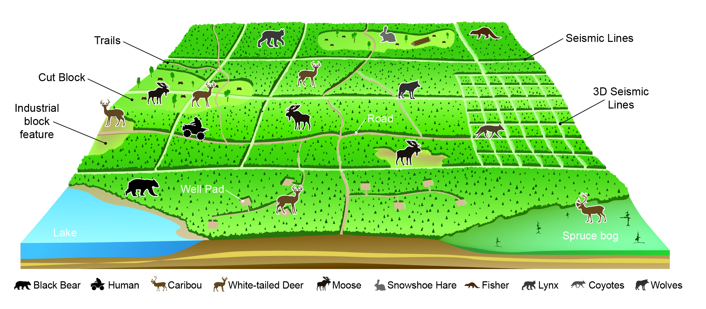

Slide 16
EVERY BOREAL MAMMAL EXAMINED WAS AFFECTED BY HUMAN-CAUSED LANDSCAPE FEATURES

Slide 17
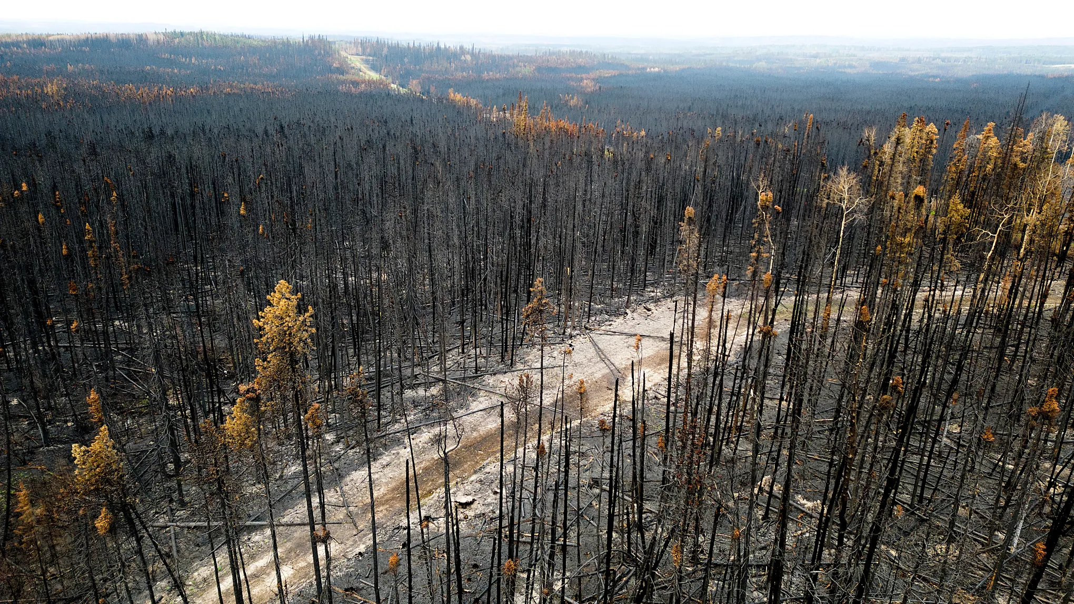
EVERYTHING WE KNOW ABOUT MAMMAL’S RESPONSE TO BURNS COMES FROM SPACE-FOR-TIME SUBSTITUTIONS
WE ASSUME LANDSCAPES FROM 100+ YEARS AGO ARE PROXIES FOR THOSE BURNING TODAY
…THIS IS LIKELY A BAD ASSUMPTION

Slide 18
TRAILS, BLAZING:
RESEARCH ON BURNED INDUSTRIAL LANDSCAPES IS NEEDED NOW TO PREDICT FUTURE MAMMAL COMMUNITIES
JASON T FISHER

